Slide 1
Amazon Web Services
Ajay J. Singala

Slide 2
About Me
I am Ajay.
Enterprise Architect, DevOps, Trainer.
~30 years experience.
Worked with global clients.
TOGAF Certified Technical Architect.

Slide 3
Agenda
AWS
IAM
EC2
VPC
EC2 Instance Storage (EBS)
AMI
S3
Load Balancing & Auto Scaling
RDS
DynamoDB
Route 53
Serverless Computing
CloudWatch

Slide 4
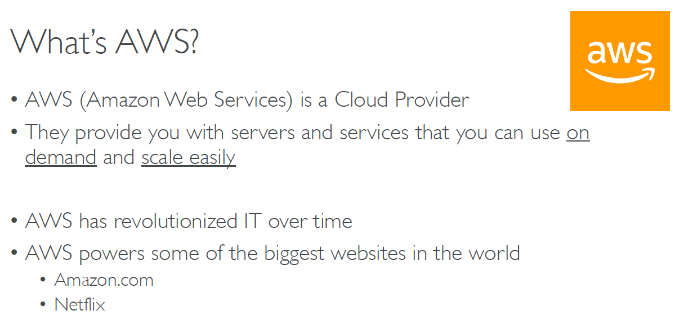

Slide 5
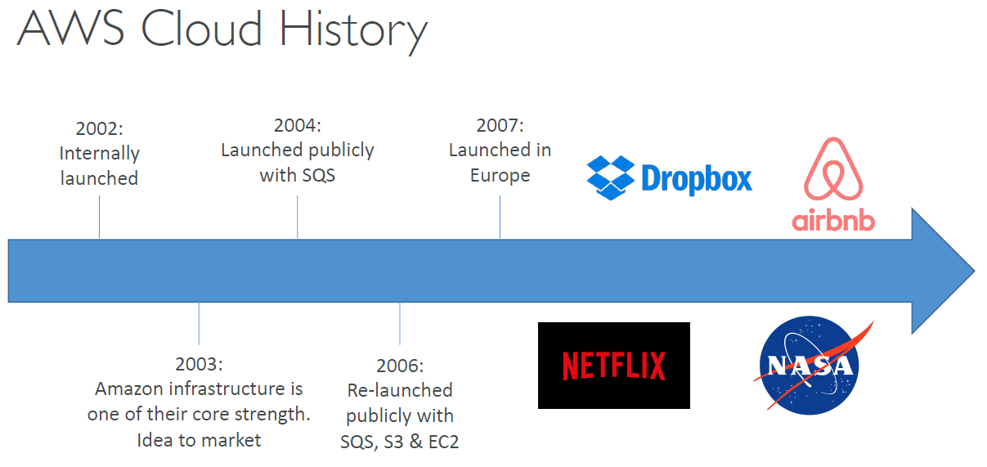

Slide 35
Virtual Private Connection (VPC)

Slide 80
Load Balancing and Auto Scaling

Slide 100
RDS (Relational Database Service)

Slide 116
DynamoDB

Slide 119
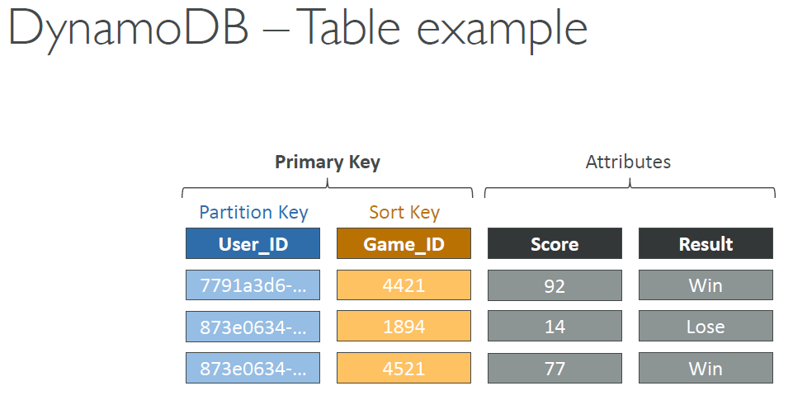

Slide 120
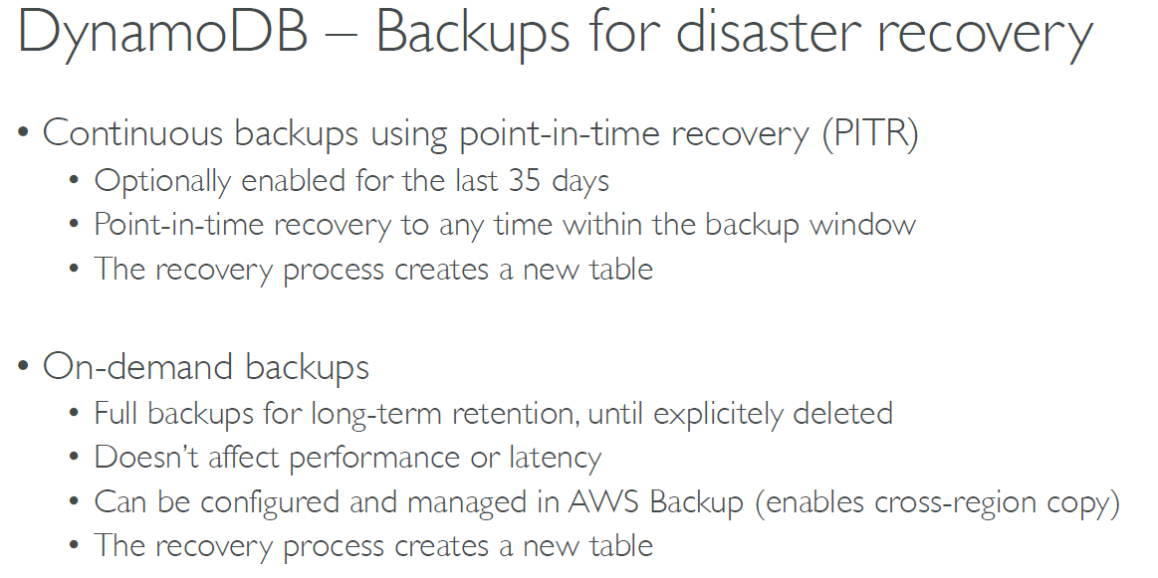

Slide 142
Serverless Computing
Lambda, API Gateway, SQS, SNS

Slide 153
Integration Services
SQS, SNS

Slide 172
Amazon CloudWatch
Monitoring

Slide 182
Thank you

